Slide 1
Protecting the Infrastructure in the world of disappearing Perimeter
Ashish Adhvaryu
5th Jan 2019

Slide 2

How Security started
Fort was isolated
Entry – exit was well defined & controlled
Adversaries were viewed from top regularly
Authorised person gets entry
Communities were safeguarded with military control

Slide 3











10 Steps of Cyber security
User awareness
Data security
Define
Maintain
Enhance
Smart phone security
Network Security
System/Application
Configuration security
Malware protection
Cyber assets
Removable media control
Security monitoring
Security Incident management
Identity management

Slide 4
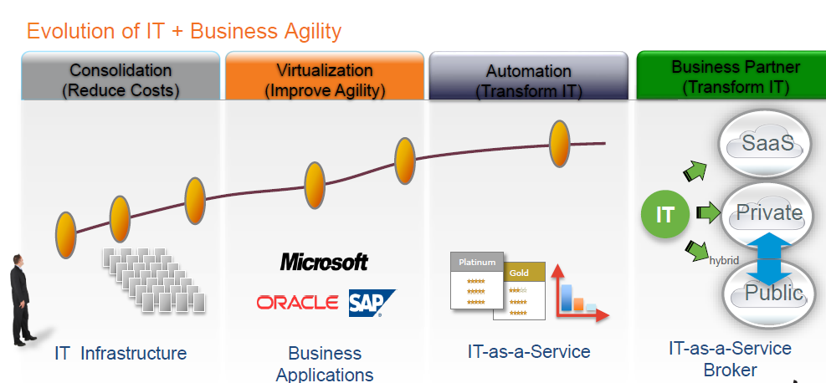
Cloud Journey

Slide 5
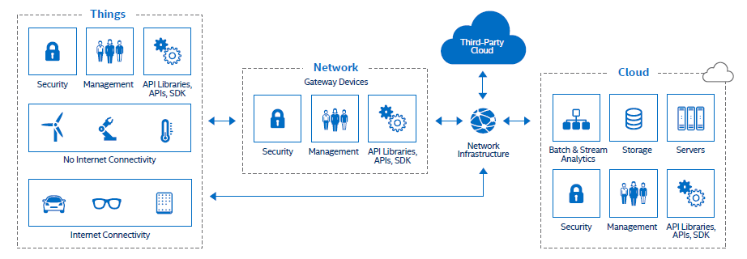
IOT Journey

Slide 6
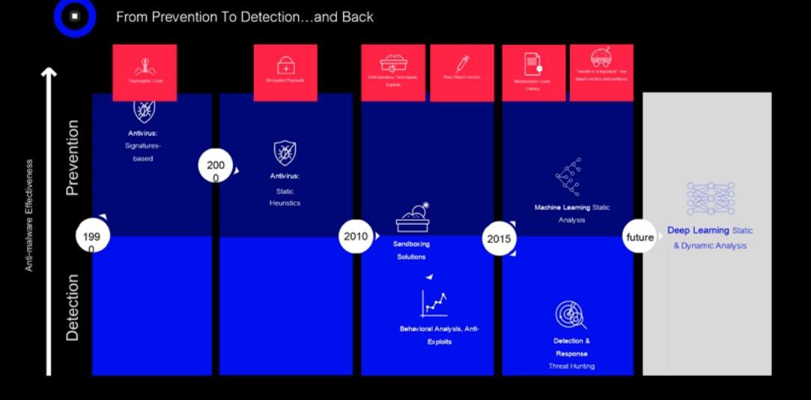
Security Journey

Slide 7
Final Thoughts
It is not strength that protect you, its Agility
It is not compliance that assure , it is Discipline
It is not what you know , it is what you do not know
It is not skill that make somebody qualified , it is behaviour & passion
Future security is not technology per se;
It is people, intelligence and automation for rapid response to threat

Slide 8
Thank you

